Slide 1

Feedback to Astronut
Score | 253.09
Matching of Lost Item1 (Level 2)
Matching of Lost Item2 (Level 1)
Matching of Lost Item3 (Level 3)
Matching of Lost Item4 (Level 4)
Rounding completion time | 114.7
Is the report item correct ?
Mission completion time | 195.3
Short Summary
Congrats on 1st place!
Time-saving techniques, such as shooting posture and simultaneous shooting in areas 2 and 3, were evident throughout.
The accuracy of the image recognition was excellent with the complete success of the mission.
The team's ingenuity in shortening the time was put to good use, and they came in first place.

Slide 2
Feedbacks
The Target Item were captured in an ingenious way. The entire area was scanned, and the direction of the target item was determined using image processing. Fine adjustments were made by rotating the Astrobee, which helped reduce the risk of localization loss.
private void goNearestArea(List<Integer> notFoundTarget ,Map<Integer,
gov.nasa.arc.astrobee.types.Point> dictionary,
List<List<Double>> angle_list){
・・・・・・・・・・・・
moveToWrapper(dictionary.get(lastIndex + 1),
computeQuaternionFromAngles(Final_turn(lastIndex + 1,0)));
・・・・・・・・・・・・ }
Good!
2

Slide 3
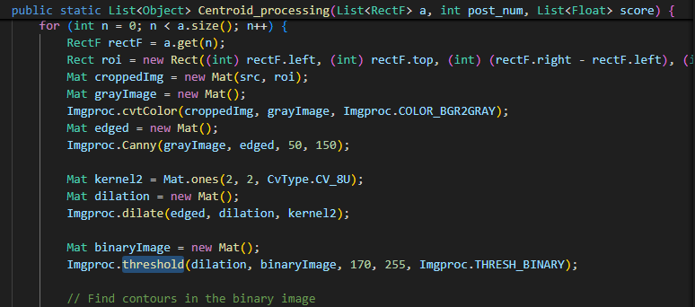
Feedbacks
There is a class that describes the processing of binarization, but it is not available, so it would be good if you could try to handle binarization next time.
CAD.java：L63
3

Slide 4
Feedbacks
Comments about maintainability
The frequently used functions, such as movement processing, have been implemented as common functions. We commend this as it shows an awareness of improving maintainability.
Since the log output is described, it is a code that is easy to deal with problems.
If you describe your comments in detail, it will make the code even more readable.
It is good that the program is designed to handle errors in case it enters the Keep Out Zone.
It was wonderful to see the high accuracy of image recognition and various techniques to save time. The ingenuity paid off, and the difference in mission accomplishment time brought them to first place!
4

